Slide 1
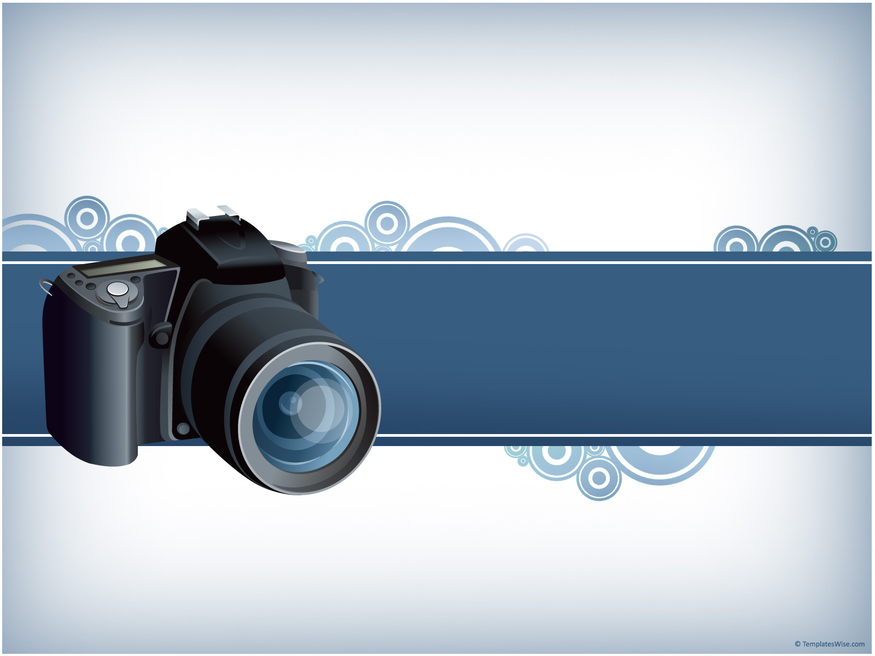
Digital Camera

Slide 2

    Department of Computer Science
  Maqsood Ahmed 38186
  M.Arsalan Zafar 38033
  Muhammad Arslan 38158
Digital Camera

Slide 3

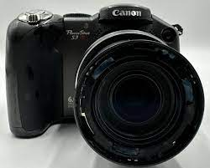
Introduction:
From Sensor to Snapshot: How Logic Circuits Craft Stunning Images
Digital Camera

Slide 4
Unveiling the Hidden Hero: Digital Logic Design (DLD)
Definition: Building blocks of digital circuits using logic gates (AND, OR, NOT) to process binary data (0s and 1s) and perform specific tasks.
Applications: Image sensors, processing circuits, autofocus, exposure control, noise reduction, image sharpening.
Digital Camera

Slide 5

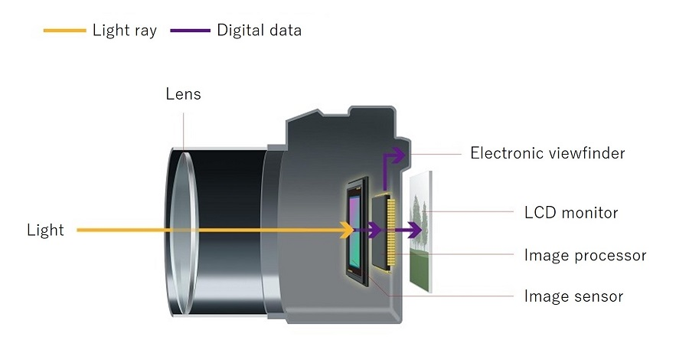
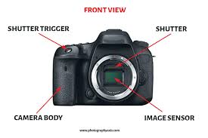

Slide 6
Capturing Light: The Role of Logic Gates in Image Sensors
Photo-diodes convert light into electrical signals (analog).
Logic circuits (amplifiers, comparators) convert analog signals to digital data (0s and 1s).
Digital Camera

Slide 7
From Pixels to Pictures: Processing Power of Logic
Autofocus: AND gates compare pixel brightness for sharp focus detection.
Exposure Control: Comparators and thresholding determine appropriate light levels for optimal exposure.
Noise Reduction: Averaging algorithms and filtering eliminate unwanted noise in images.
Image Sharpening: Edge detection using logic circuits enhances details and clarity.
Digital Camera

Slide 8
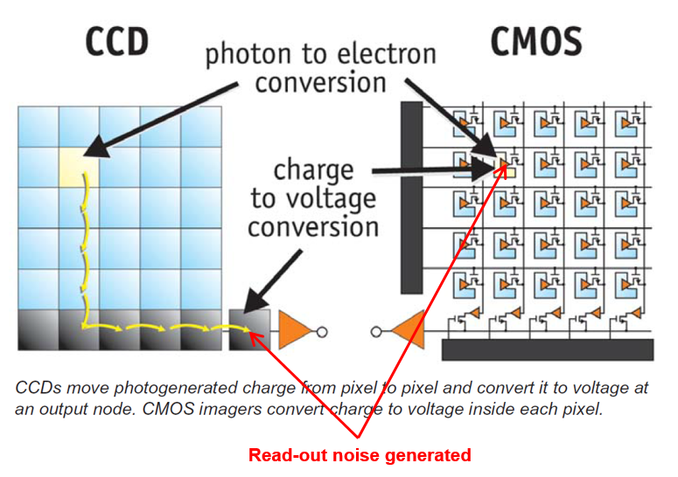

Slide 9
The Impact of DLD on Image Quality
Reduced noise and artifacts.
Sharper details and crisper edges.
Accurate color representation.
Improved dynamic range and exposure balance.
Digital Camera

Slide 10
The Future of Digital Cameras: More Logic, More Magic
Higher resolution sensors: Capturing even finer details.
Artificial Intelligence (AI): Automating functions like scene recognition, object tracking.
Immersive Experiences: 3D photography and virtual reality integration.
Digital Camera

Slide 11
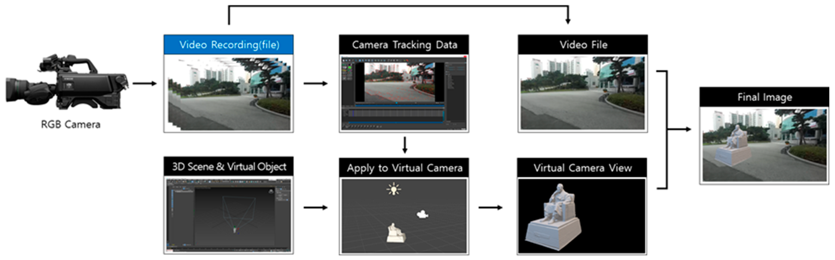

Slide 12
Conclusion:
DLD plays a crucial role in capturing light, processing data, and delivering high-quality images.
Advancements in DLD promise even more stunning and intelligent photography experiences in the future.
Digital Camera

Slide 13
THANK YOU

